Slide 1
The Smith-Waterman algorithm
Dr Avril Coghlan
alc@sanger.ac.uk
Note: this talk contains animations which can only be seen by
downloading and using ‘View Slide show’ in Powerpoint

Slide 2
Global versus Local Alignment
A global alignment covers the entire lengths of the sequences involved
The Needleman-Wunsch algorithm finds the best global alignment between 2 sequences
A local alignment only covers parts of the sequences
The Smith-Waterman algorithm finds the best local alignment between 2 sequences
Global alignment
Local alignment
Q K E S G P S S S Y C
| | | | |
V Q Q E S G L V R T T C
E S G
| | |
E S G

Slide 3
Local alignment
The concept of ‘local alignment’ was introduced by Smith & Waterman in 1981
A local alignment of 2 sequences is an alignment between parts of the 2 sequences
Two proteins may one share one stretch of high sequence similarity, but be very dissimilar outside that region
A global (N-W) alignment of such sequences would have:
(i) lots of matches in the region of high sequence similarity
(ii) lots of mismatches & gaps (insertions/deletions) outside the region of similarity
It makes sense to find the best local alignment instead
Notes:
Image credit (Temple Smith): http://www.modulargenetics.com/Temple%20Smith.jpg
Image credit (Michael Waterman): http://www.iscb.org/cms_addon/conferences/ismb2003/images/watterman.jpg

Slide 4
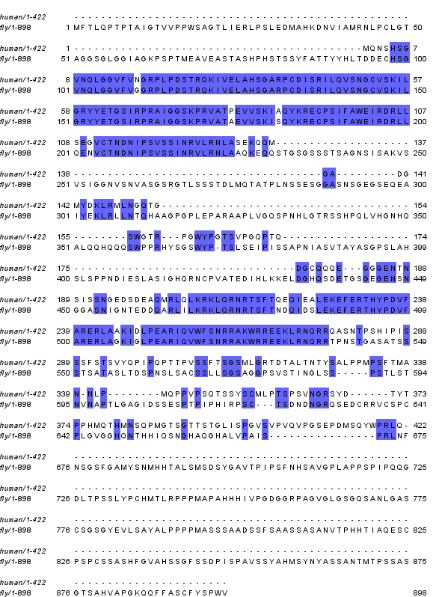
Real data: fruitfly & human Eyeless
This is a global alignment of human & fruitfly Eyeless
Do you think it’s sensible to make a global alignment of these two sequences?
Notes:
Made alignment of human.fa and fly.fa using Needleman-wunsch with default parameters at:
http://emboss.bioinformatics.nl/cgi-bin/emboss/needle (EMBOSS needle)
Human Eyeless (PAX6) from: http://www.treefam.org/cgi-bin/TFseq.pl?id=ENST00000379111.1
D. Melanogaster Eyeless from: http://www.treefam.org/cgi-bin/TFseq.pl?id=FBtr0100396.5
Viewed in jalview, and saved as humanfly_needlemanwunsch.png

Slide 5
Real data: fruitfly & human Eyeless
There are 2 short regions of high similarity
Outside those regions, there are many mismatches and gaps
It might be more sensible to make local alignments of one or both of the regions of high similarity

Slide 6
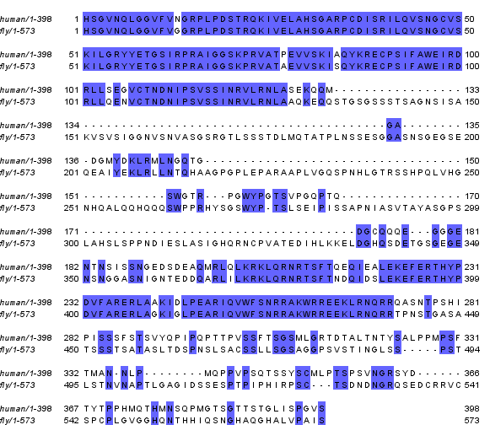
Real data: fruitfly & human Eyeless
This is a local alignment of human & fruitfly Eyeless
What parts of the sequences were used in the local alignment?
Notes:
Made alignment of human.fa and fly.fa using Smith-Waterman with default parameters at:
http://emboss.bioinformatics.nl/cgi-bin/emboss/water (EMBOSS)
Human Eyeless (PAX6) from: http://www.treefam.org/cgi-bin/TFseq.pl?id=ENST00000379111.1
D. Melanogaster Eyeless from: http://www.treefam.org/cgi-bin/TFseq.pl?id=FBtr0100396.5
Viewed in jalview, and saved as humanfly_smithwaterman.png

Slide 7
The Smith-Waterman algorithm
S-W is mathematically proven to find the best (highest-scoring) local alignment of 2 sequences
The best local alignment is the best alignment of all possible subsequences (parts) of sequences S₁ and S₂
The 0th row and 0th column of T are first filled with zeroes
The recurrence relation used to fill table T is:
  T(i-1, j-1) + σ(S₁(i), S₂(j))
T(i, j) = max T(i-1, j) + gap penalty
T(i, j-1) + gap penalty
0
The traceback starts at the highest scoring cell in the matrix T, and travels up/left while the score is still positive
(While in N-W, traceback starts at the bottom right, & ends at the top left, which ensures it’s a global alignment)
A 4th possibility (unlike N-W)

Slide 8
eg., to find the best local alignment of sequences “ACCTAAGG” and “GGCTCAATCA”, using +2 for a match, -1 for a mismatch, and -2 for a gap:
We first make matrix T (as in N-W):
The 0th row and 0th column of T are filled with zeroes
The recurrence relation is then used to fill the matrix T
 |  | G | G | C | T | C | A | A | T | C | A
A
C
C
T
A
A
G
G
 |  | G | G | C | T | C | A | A | T | C | A
 | 0 | 0 | 0 | 0 | 0 | 0 | 0 | 0 | 0 | 0 | 0
A | 0
C | 0
C | 0
T | 0
A | 0
A | 0
G | 0
G | 0

Slide 9
We first calculate T(1,1) using the recurrence relation:
  T(i-1, j-1) + σ(S₁(i), S₂(j)) = 0 – 1 = -1
T(i, j) = max T(i-1, j) + gap penalty = 0 -2 = -2
T(i, j-1) + gap penalty = 0 -2 = -2
0
The maximum value is 0, so we set T(1,1) to 0
We next calculate T(2,1)…
 |  | G | G | C | T | C | A | A | T | C | A
 | 0 | 0 | 0 | 0 | 0 | 0 | 0 | 0 | 0 | 0 | 0
A | 0 | ?
C | 0
C | 0
T | 0
A | 0
A | 0
G | 0
G | 0
 |  | G | G | C | T | C | A | A | T | C | A
 | 0 | 0 | 0 | 0 | 0 | 0 | 0 | 0 | 0 | 0 | 0
A | 0 | 0
C | 0
C | 0
T | 0
A | 0
A | 0
G | 0
G | 0
 |  | G | G | C | T | C | A | A | T | C | A
 | 0 | 0 | 0 | 0 | 0 | 0 | 0 | 0 | 0 | 0 | 0
A | 0 | 0 | ?
C | 0
C | 0
T | 0
A | 0
A | 0
G | 0
G | 0

Slide 10
You fill in the whole of T, recording the previous cell (if any) used to calculate the value of each T(i, j):
The traceback starts at the highest scoring cell in the matrix T, and travels up/left while the score is still positive
 |  | G | G | C | T | C | A | A | T | C | A
 | 0 | 0 | 0 | 0 | 0 | 0 | 0 | 0 | 0 | 0 | 0
A | 0 | 0 | 0 | 0 | 0 | 0 | 2 | 2 | 0 | 0 | 2
C | 0 | 0 | 0 | 2 | 0 | 2 | 0 | 1 | 1 | 2 | 0
C | 0 | 0 | 0 | 2 | 1 | 2 | 1 | 0 | 0 | 3 | 1
T | 0 | 0 | 0 | 0 | 4 | 2 | 1 | 0 | 2 | 1 | 2
A | 0 | 0 | 0 | 0 | 2 | 3 | 4 | 3 | 1 | 1 | 3
A | 0 | 0 | 0 | 0 | 0 | 1 | 5 | 6 | 4 | 2 | 3
G | 0 | 2 | 2 | 0 | 0 | 0 | 3 | 4 | 5 | 3 | 1
G | 0 | 2 | 4 | 2 | 0 | 0 | 1 | 2 | 3 | 4 | 2
 |  | G | G | C | T | C | A | A | T | C | A
 | 0 | 0 | 0 | 0 | 0 | 0 | 0 | 0 | 0 | 0 | 0
A | 0 | 0 | 0 | 0 | 0 | 0 | 2 | 2 | 0 | 0 | 2
C | 0 | 0 | 0 | 2 | 0 | 2 | 0 | 1 | 1 | 2 | 0
C | 0 | 0 | 0 | 2 | 1 | 2 | 1 | 0 | 0 | 3 | 1
T | 0 | 0 | 0 | 0 | 4 | 2 | 1 | 0 | 2 | 1 | 2
A | 0 | 0 | 0 | 0 | 2 | 3 | 4 | 3 | 1 | 1 | 3
A | 0 | 0 | 0 | 0 | 0 | 1 | 5 | 6 | 4 | 2 | 3
G | 0 | 2 | 2 | 0 | 0 | 0 | 3 | 4 | 5 | 3 | 1
G | 0 | 2 | 4 | 2 | 0 | 0 | 1 | 2 | 3 | 4 | 2
 |  | G | G | C | T | C | A | A | T | C | A
 | 0 | 0 | 0 | 0 | 0 | 0 | 0 | 0 | 0 | 0 | 0
A | 0 | 0 | 0 | 0 | 0 | 0 | 2 | 2 | 0 | 0 | 2
C | 0 | 0 | 0 | 2 | 0 | 2 | 0 | 1 | 1 | 2 | 0
C | 0 | 0 | 0 | 2 | 1 | 2 | 1 | 0 | 0 | 3 | 1
T | 0 | 0 | 0 | 0 | 4 | 2 | 1 | 0 | 2 | 1 | 2
A | 0 | 0 | 0 | 0 | 2 | 3 | 4 | 3 | 1 | 1 | 3
A | 0 | 0 | 0 | 0 | 0 | 1 | 5 | 6 | 4 | 2 | 3
G | 0 | 2 | 2 | 0 | 0 | 0 | 3 | 4 | 5 | 3 | 1
G | 0 | 2 | 4 | 2 | 0 | 0 | 1 | 2 | 3 | 4 | 2
 |  | G | G | C | T | C | A | A | T | C | A
 | 0 | 0 | 0 | 0 | 0 | 0 | 0 | 0 | 0 | 0 | 0
A | 0 | 0 | 0 | 0 | 0 | 0 | 2 | 2 | 0 | 0 | 2
C | 0 | 0 | 0 | 2 | 0 | 2 | 0 | 1 | 1 | 2 | 0
C | 0 | 0 | 0 | 2 | 1 | 2 | 1 | 0 | 0 | 3 | 1
T | 0 | 0 | 0 | 0 | 4 | 2 | 1 | 0 | 2 | 1 | 2
A | 0 | 0 | 0 | 0 | 2 | 3 | 4 | 3 | 1 | 1 | 3
A | 0 | 0 | 0 | 0 | 0 | 1 | 5 | 6 | 4 | 2 | 3
G | 0 | 2 | 2 | 0 | 0 | 0 | 3 | 4 | 5 | 3 | 1
G | 0 | 2 | 4 | 2 | 0 | 0 | 1 | 2 | 3 | 4 | 2
 |  | G | G | C | T | C | A | A | T | C | A
 | 0 | 0 | 0 | 0 | 0 | 0 | 0 | 0 | 0 | 0 | 0
A | 0 | 0 | 0 | 0 | 0 | 0 | 2 | 2 | 0 | 0 | 2
C | 0 | 0 | 0 | 2 | 0 | 2 | 0 | 1 | 1 | 2 | 0
C | 0 | 0 | 0 | 2 | 1 | 2 | 1 | 0 | 0 | 3 | 1
T | 0 | 0 | 0 | 0 | 4 | 2 | 1 | 0 | 2 | 1 | 2
A | 0 | 0 | 0 | 0 | 2 | 3 | 4 | 3 | 1 | 1 | 3
A | 0 | 0 | 0 | 0 | 0 | 1 | 5 | 6 | 4 | 2 | 3
G | 0 | 2 | 2 | 0 | 0 | 0 | 3 | 4 | 5 | 3 | 1
G | 0 | 2 | 4 | 2 | 0 | 0 | 1 | 2 | 3 | 4 | 2
 |  | G | G | C | T | C | A | A | T | C | A
 | 0 | 0 | 0 | 0 | 0 | 0 | 0 | 0 | 0 | 0 | 0
A | 0 | 0 | 0 | 0 | 0 | 0 | 2 | 2 | 0 | 0 | 2
C | 0 | 0 | 0 | 2 | 0 | 2 | 0 | 1 | 1 | 2 | 0
C | 0 | 0 | 0 | 2 | 1 | 2 | 1 | 0 | 0 | 3 | 1
T | 0 | 0 | 0 | 0 | 4 | 2 | 1 | 0 | 2 | 1 | 2
A | 0 | 0 | 0 | 0 | 2 | 3 | 4 | 3 | 1 | 1 | 3
A | 0 | 0 | 0 | 0 | 0 | 1 | 5 | 6 | 4 | 2 | 3
G | 0 | 2 | 2 | 0 | 0 | 0 | 3 | 4 | 5 | 3 | 1
G | 0 | 2 | 4 | 2 | 0 | 0 | 1 | 2 | 3 | 4 | 2
Notes:
In R:
>library("Biostrings")
>seq1 <- "GGCTCAATCA"
>seq2 <- "ACCTAAGG"
>sigma <- nucleotideSubstitutionMatrix(match = 2, mismatch = -1, baseOnly = TRUE)
>pairwiseAlignment(seq1, seq2, substitutionMatrix = sigma, gapOpening = 0, gapExtension = -2,
scoreOnly = FALSE,type="local")
dFixedSubject (1 of 1)
pattern: [3] CTCAA
subject: [3] CT-AA
score: 6
Also:
>source("C:/Documents and Settings/Avril Coughlan/My Documents/Rfunctions.R") >dnasmithwaterman(seq1,seq2,gapopen=0,gapextend=-2,mymatch=2,mymismatch=-1)
[1] "maxT= 6"
NA G G C T C A A T C A
NA NA NA NA NA NA NA NA NA NA NA NA
A NA "0 +" "0 +" "0 +" "0 +" "0 +" "2 >" "2 >" "0 -" "0 +" "2 >"
C NA "0 +" "0 +" "2 >" "0 -" "2 >" "0 L" "1 >" "1 >" "2 >" "0 L"
C NA "0 +" "0 +" "2 >" "1 >" "2 >" "1 >" "0 +" "0 >" "3 >" "1 Z"
T NA "0 +" "0 +" "0 |" "4 >" "2 -" "1 >" "0 >" "2 >" "1 |" "2 >"
A NA "0 +" "0 +" "0 +" "2 |" "3 >" "4 >" "3 >" "1 -" "1 >" "3 >"
A NA "0 +" "0 +" "0 +" "0 |" "1 V" "5 >" "6 >" "4 -" "2 -" "3 >"
G NA "2 >" "2 >" "0 -" "0 +" "0 +" "3 |" "4 V" "5 >" "3 Z" "1 *"
G NA "2 >" "4 >" "2 -" "0 -" "0 +" "1 |" "2 V" "3 V" "4 >" "2 Z“
NOTE: there seems to be a mistake in the Deonier book for this example on page 157 of Deonier – it has “... 2 3 4 3 2 1 3” on one row, but should have “ ... 2 3 4 3 1 1 3” on that row (row i =5).

Slide 11
 |  | G | G | C | T | C | A | A | T | C | A
 | 0 | 0 | 0 | 0 | 0 | 0 | 0 | 0 | 0 | 0 | 0
A | 0 | 0 | 0 | 0 | 0 | 0 | 2 | 2 | 0 | 0 | 2
C | 0 | 0 | 0 | 2 | 0 | 2 | 0 | 1 | 1 | 2 | 0
C | 0 | 0 | 0 | 2 | 1 | 2 | 1 | 0 | 0 | 3 | 1
T | 0 | 0 | 0 | 0 | 4 | 2 | 1 | 0 | 2 | 1 | 2
A | 0 | 0 | 0 | 0 | 2 | 3 | 4 | 3 | 1 | 1 | 3
A | 0 | 0 | 0 | 0 | 0 | 1 | 5 | 6 | 4 | 2 | 3
G | 0 | 2 | 2 | 0 | 0 | 0 | 3 | 4 | 5 | 3 | 1
G | 0 | 2 | 4 | 2 | 0 | 0 | 1 | 2 | 3 | 4 | 2
You work out the best local alignment from the traceback (just like in N-W):
The score of the alignment is in the bottom right cell of the traceback (6 = 4×(score of 2 per match) + 1×(-2 per gap))
C
|
C
T
|
T
C
-
A
|
A
A
|
A

Slide 12
Software for making alignments
For Smith-Waterman pairwise alignment
pairwiseAlignment() in the “Biostrings” R library
the EMBOSS (emboss.sourceforge.net/) water program

Slide 13
Problem
Find the best local alignment between “TCAGTTGCC” & “AGGTTG”, with +1 for a match, -2 for a mismatch, and -2 for a gap.

Slide 14
Answer
Find the best local alignment between “TCAGTTGCC” & “AGGTTG”, with +1 for a match, -2 for a mismatch, and -2 for a gap
Matrix T looks like this, with the pink traceback:
Alignment:
 |  | T | C | A | G | T | T | G | C | C
 | 0 | 0 | 0 | 0 | 0 | 0 | 0 | 0 | 0 | 0
A | 0 | 0 | 0 | 1 | 0 | 0 | 0 | 0 | 0 | 0
G | 0 | 0 | 0 | 0 | 2 | 0 | 0 | 1 | 0 | 0
G | 0 | 0 | 0 | 0 | 1 | 0 | 0 | 1 | 0 | 0
T | 0 | 1 | 0 | 0 | 0 | 2 | 1 | 0 | 0 | 0
T | 0 | 1 | 0 | 0 | 0 | 1 | 3 | 1 | 0 | 0
G | 0 | 0 | 0 | 0 | 1 | 0 | 1 | 4 | 2 | 0
G
|
G
T
|
T
T
|
T
G
|
G
(Pink traceback)
Notes:
In R:
>library("Biostrings")
>seq1 <- "TCAGTTGCC"
>seq2 <- "AGGTTG"
>sigma <- nucleotideSubstitutionMatrix(match = 1, mismatch = -2, baseOnly = TRUE)
>pairwiseAlignment(seq1, seq2, substitutionMatrix = sigma, gapOpening = 0, gapExtension = -2,
scoreOnly = FALSE,type="local")
Local PairwiseAlignedFixedSubject (1 of 1)
pattern: [4] GTTG
subject: [3] GTTG
score: 4
Also:
>source("C:/Documents and Settings/Avril Coughlan/My Documents/Rfunctions.R") >dnasmithwaterman(seq1,seq2,gapopen=0,gapextend=-2,mymatch=1,mymismatch=-2)
[1] "maxT= 4"
NA T C A G T T G C C
NA NA NA NA NA NA NA NA NA NA NA
A NA "0 +" "0 +" "1 >" "0 +" "0 +" "0 +" "0 +" "0 +" "0 +"
G NA "0 +" "0 +" "0 +" "2 >" "0 -" "0 +" "1 >" "0 +" "0 +"
G NA "0 +" "0 +" "0 +" "1 >" "0 >" "0 +" "1 >" "0 +" "0 +"
T NA "1 >" "0 +" "0 +" "0 +" "2 >" "1 >" "0 +" "0 +" "0 +"
T NA "1 >" "0 +" "0 +" "0 +" "1 >" "3 >" "1 -" "0 +" "0 +"
G NA "0 +" "0 +" "0 +" "1 >" "0 +" "1 |" "4 >" "2 -" "0 -"

Slide 15
Further Reading
Chapter 3 in Introduction to Computational Genomics Cristianini & Hahn
Chapter 6 in Deonier et al Computational Genome Analysis
Practical on pairwise alignment in R in the Little Book of R for Bioinformatics:
https://a-little-book-of-r-for-bioinformatics.readthedocs.org/en/latest/src/chapter4.html

